Slide 1
Chapter 7 Design and Implementation

Slide 2
Topics covered
Object-oriented design using the UML
Design patterns
Implementation issues
Open source development

Slide 3
Design and implementation
Software design and implementation is the stage in the software engineering process at which an executable software system is developed.
Software design and implementation activities are invariably inter-leaved.
Software design is a creative activity in which you identify software components and their relationships, based on a customer’s requirements.
Implementation is the process of realizing the design as a program.

Slide 4
Build or Buy
In a wide range of domains, it is now possible to buy off-the-shelf systems (COTS) that can be adapted and tailored to the users’ requirements.
For example, if you want to implement a medical records system, you can buy a package that is already used in hospitals. It can be cheaper and faster to use this approach rather than developing a system in a conventional programming language.
When you develop an application in this way, the design process becomes concerned with how to use the configuration features of that system to deliver the system requirements.

Slide 5
An object-oriented design process using the UML
Structured object-oriented design processes involve developing several different system models.
They require a lot of effort for the development and maintenance of these models and, for small systems, this may not be cost-effective.
However, for large systems developed by different groups design models are an important communication mechanism.

Slide 6
Process stages
There are a variety of different object-oriented design processes that depend on the organization using the process.
Common activities in these processes include:
Define the context and modes of use of the system;
Design the system architecture;
Identify the principal system objects;
Develop design models;
Specify object interfaces.
Process illustrated here using a design for a wilderness weather station.

Slide 7
System context and interactions
Understanding the relationships between the software that is being designed and its external environment is essential for deciding how to provide the required system functionality and how to structure the system to communicate with its environment.
Understanding the context also lets you establish the boundaries of the system.
Setting the system boundaries helps you decide what features are implemented in the system being designed and what features are in other associated systems.

Slide 8
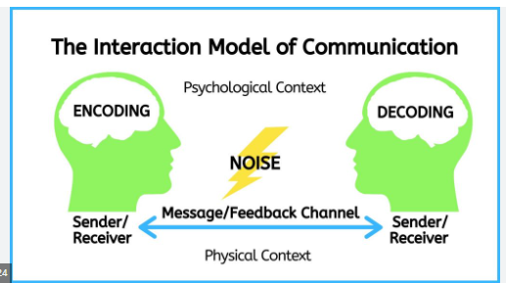
Context and interaction models
A system context model is a structural model that demonstrates the other systems in the environment of the system being developed.
An interaction model is a dynamic model that shows how the system interacts with its environment as it is used.

Slide 9
System context for the weather station

Slide 10
Weather station use cases

Slide 11
Use case description—Report weather
System | Weather station
Use case | Report weather
Actors | Weather information system, Weather station
Description | The weather station sends a summary of the weather data that has been collected from the instruments in the collection period to the weather information system. The data sent are the maximum, minimum, and average ground and air temperatures; the maximum, minimum, and average air pressures; the maximum, minimum, and average wind speeds; the total rainfall; and the wind direction as sampled at five-minute intervals.
Stimulus | The weather information system establishes a satellite communication link with the weather station and requests transmission of the data.
Response | The summarized data is sent to the weather information system.
Comments | Weather stations are usually asked to report once per hour but this frequency may differ from one station to another and may be modified in the future.

Slide 12
Architectural Design
Once interactions between the system and its environment have been understood, you use this information for designing the system architecture.
You identify the major components that make up the system and their interactions, and then may organize the components using an architectural pattern such as a layered or client-server model.
The weather station is composed of independent subsystems that communicate by broadcasting messages on a common infrastructure.

Slide 13
High-level architecture of the weather station

Slide 14
Architecture of data collection system
الارسال

Slide 15
Object class identification
Identifying object classes is often a difficult part of object oriented design.
There is no 'magic formula' for object identification. It relies on the skill, experience, and domain knowledge of system designers.
Object identification is an iterative process. You are unlikely to get it right first time.

Slide 16
Approaches to identification
Use a grammatical approach based on a natural language description of the system.وصف لغوي
Base the identification on tangible things in the application domain.
Use a behavioural approach and identify objects based on what participates in what behavior.
Use a scenario-based analysis. The objects, attributes, and methods in each scenario are identified.

Slide 17
Weather station object classes
Object class identification in the weather station system may be based on the tangible hardware and data in the system:
Ground thermometer, Anemometer, Barometer
Application domain objects are ‘hardware’ objects related to the instruments in the system.
Weather station
The basic interface of the weather station to its environment. It therefore reflects the interactions identified in the use-case model.
Weather data
Encapsulates the summarized data from the instruments.تجميع عناصر الطقس

Slide 18
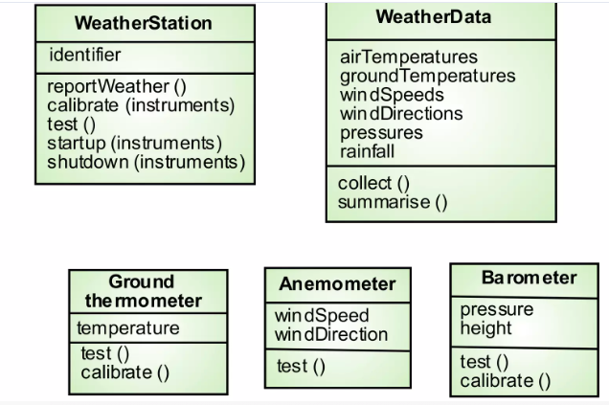
Weather station object classes

Slide 19
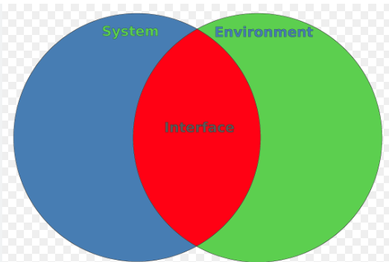
Interface specification
Object interfaces have to be specified so that the objects and other components can be designed in parallel.
Objects may have several interfaces which are viewpoints on the methods provided.
The UML uses class diagrams for interface specification but Java may also be used.

Slide 20
Implementation issues
The focus here is not on programming, although this is important, but on other implementation issues that are often not covered in programming texts:
Reuse Most modern software is constructed by reusing existing components or systems. When developing software, you should use existing code as much as possible.
Configuration management During the development process, you must keep track of the many different versions of each software component in a configuration management system.
Host-target development Production software does not usually execute on the same computer as the software development environment. Rather, you develop it on one computer (the host system) and execute it on a separate computer (the target system).

Slide 21
Reuse
From the 1960s to the 1990s, most new software was developed from scratch, by writing all code in a high-level programming language.
The only significant reuse of software was the reuse of functions and objects in programming language libraries.
Costs and schedule pressure mean that this approach became increasingly impracticable, especially for commercial and Internet-based systems. غير عملي
An approach to development based on the reuse of existing software emerged and is now generally used for business and scientific software.

Slide 22
Reuse levels
The abstraction level
At this level, you don’t reuse software directly but use knowledge of successful abstractions in the design of your software.
The object level
At this level, you directly reuse objects from a library rather than writing the code yourself. (math.h)
The component level
Components are collections of objects and object classes that you reuse in application systems.
The system level
At this level, you reuse entire application systems.

Slide 23
Software reuse

Slide 24
Reuse costs
The costs of the time spent in looking for software to reuse and assessing whether or not it meets your needs.
The costs of buying reusable software. For large off-the-shelf systems, these costs can be very high.
The costs of adapting and configuring the reusable software components or systems to reflect the requirements of the system that you are developing.
The costs of integrating reusable software elements (if you are using software from different sources) and with the new code that you have developed.

Slide 25
Configuration management tool interaction

Slide 26
Development platform tools
An integrated compiler and syntax-directed editing system that allows you to create, edit and compile code.
A language debugging system.
Graphical editing tools, such as tools to edit UML models.
Testing tools, such as Junit can automatically run a set of tests on a new version of a program.
Project support tools that help you organize the code for different development projects.

Slide 27
Open Source Development اتاحة الفرصة لجميع المبرمجين والمستخدمين للتعديل وفحص البرمجيات
Open source development is an approach to software development in which the source code of a software system is published and volunteers are invited to participate in the development process
Its roots are in the Free Software Foundation (www.fsf.org), which means that source code should not be exclusive but always available for users to examine and modify as they wish.
Open-source software extended this idea by using the Internet to recruit a much larger population of volunteer developers.

Slide 28
Open source systems
The best-known open-source product is the Linux operating system, widely used as a server and, increasingly, as a desktop environment.
Other important open-source products are Java, the Apache web server, and the MySQL database management system.

Slide 29
Open source business
More and more product companies are using an open-source approach to development.
Their business model is not dependent on selling a software product but on selling support for that product.
They believe that involving the open-source community will: بيع وتقديم خدمات
developed more cheaply,
more quickly
will create a community of users for the software.

Slide 30
Open source licensing التراخيص
A fundamental principle of open-source development is that source code should be freely available, this does not mean that anyone can do as they wish with that code.
Legally, the developer of the code (either a company or an individual) still owns the code.
They can place restrictions on how it is used by including legally required conditions in an open-source software license.
Some open-source developers believe that if an open-source component is used to develop a new system, then that system should also be open-source. البرمجيات المتاحة لازم تظل متاحة للجميع
Others are willing to allow their code to be used without this restriction. استخدام بدون قيود

Slide 31
License models
The GNU General Public License (GPL). means that if you use open-source software that is licensed under the GPL license, then you must make that software open-source.
General Public License (LGPL) is a variant of the GPL license where you can write components that link to open-source code without having to publish the source of these components.
The Berkley Standard Distribution (BSD). which means you are not obliged to re-publish any changes or modifications made to open-source code. You can include the code in exclusive systems that are sold. بدون اعادة نشر او تعديل

Slide 32
License Management
Be aware of the different types of licenses and understand how a component is licensed before it is used. (choose model)
Be aware of evolution pathways for components.
Educate people about open source.
Have auditing systems in place.
Participate in the open-source community.

Slide 33
The End

